Slide 1
Data Analysis SPOTIFY X YOUTUBE
#5dataglowup

Slide 2
INTRODUCTION
The present work aimed to analyze music data on streaming platforms, specifically Spotify and YouTube, using the Pandas library in Python to create visual graphs and obtain business insights.
The present work aimed to analyze music data on streaming platforms, specifically Spotify and YouTube, using the Pandas library in Python to create visual graphs and obtain business insights.
The Pandas library was employed to load and manipulate the data, performing filtering operations, aggregation, and statistical calculations to obtain relevant information. Next, visual graphs were created using the Matplotlib data visualization library to present the results in a clear and objective way.

Slide 3
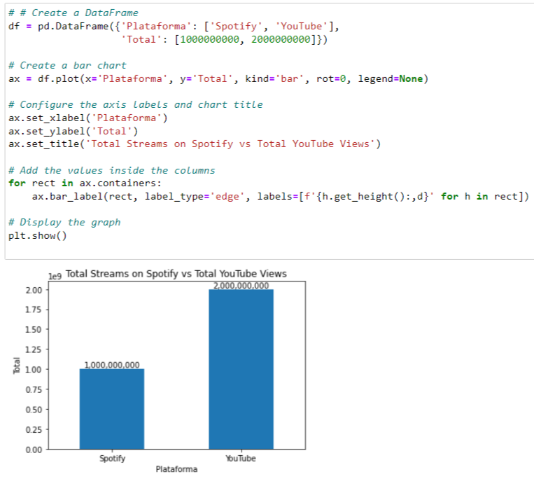
Total Streams on Spotify vs Total YouTube Views
Platform Popularity: YouTube has twice as many views compared to Spotify, indicating that it is a more popular platform in terms of user reach and engagement. Platform Popularity: YouTube has twice as many views compared to Spotify, indicating that it is a more popular platform in terms of user reach and engagement.
Promotion Strategies: Companies can adjust their promotion strategies and resource allocation based on the differences in popularity between Spotify and YouTube. For example, they may consider investing in targeted marketing campaigns on YouTube to extend their reach and audience engagement.

Slide 4
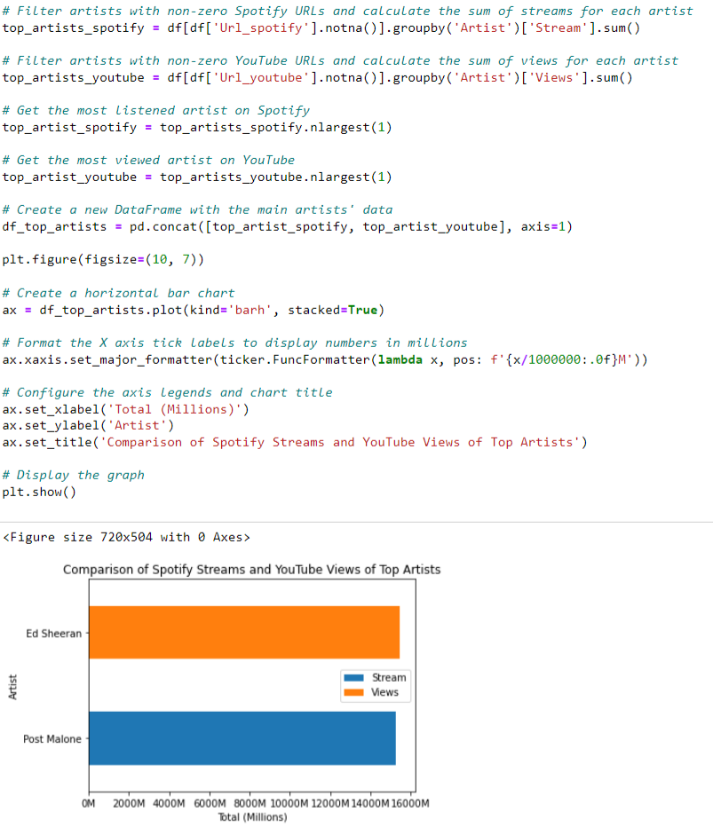
Comparison of Spotify Streams and YouTube Views of Top Artists
Popularity on streaming platforms: The chart compares the total streams on Spotify and the total views on YouTube for the top artists. This can provide valuable information about the popularity of the artists on both streaming platforms. If an artist has a high number of streams on Spotify and low number of views on YouTube, it may indicate that their content is more popular on Spotify compared to YouTube, and vice versa. This can influence the marketing and promotion strategies of these artists on each platform

Slide 5
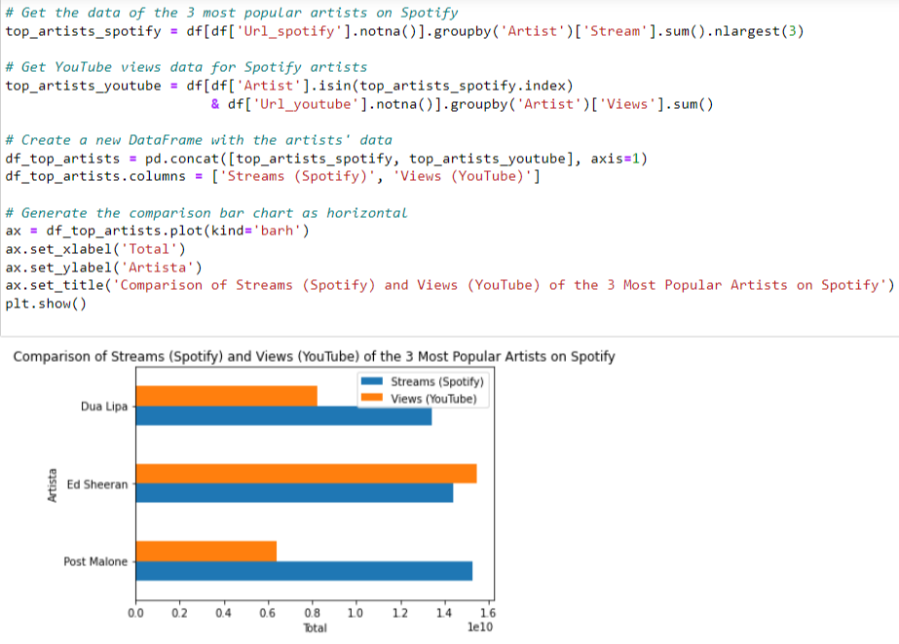
Comparison of Streams (Spotify) and Views (YouTube) of the 3 Most Popular Artists on Spotify

Slide 6
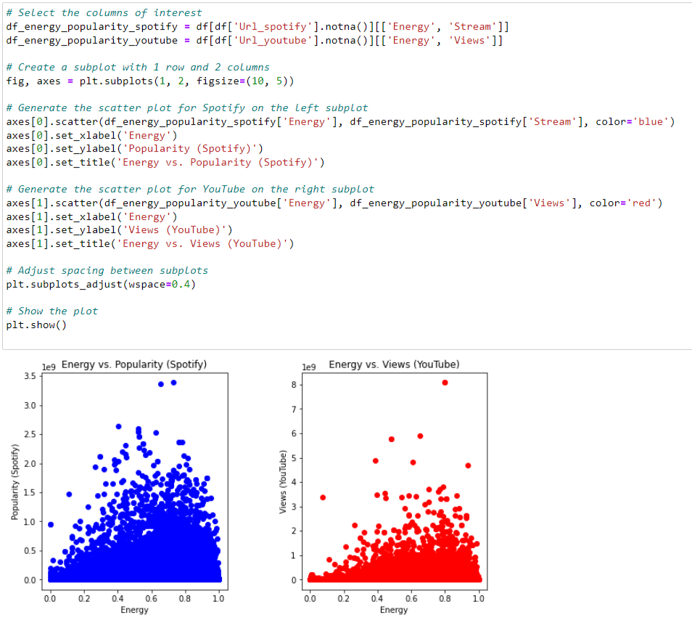
Energy vs. Popularity
Popularity vs Energy: Using the scatter plot, it is possible to visualize whether there is any relationship or pattern between the energy of the songs and their popularity on the Spotify and YouTube platforms. For example, one can observe if more energetic songs tend to have a higher popularity in terms of streams on Spotify or views on YouTube. The blue color is used to represent the dots on the graph that correspond to the songs on Spotify.

Slide 7
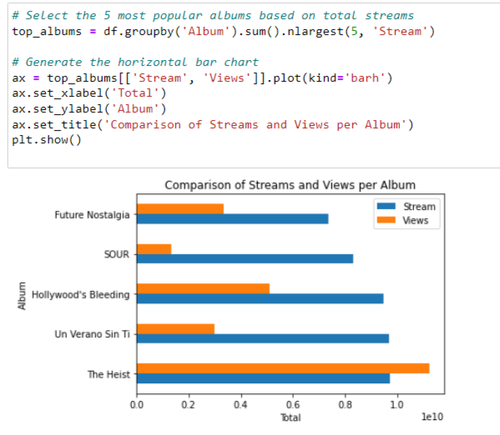
Comparison of Streams and Views per Album
Album popularity: Using the horizontal bar chart, you can identify the 5 most popular albums based on total streams. This can provide valuable information about which albums are getting the most traction on streaming (Spotify) and video sharing (YouTube) platforms. This information can be used to drive marketing and promotion strategies, as well as for decision making related to the production of music content.

Slide 8
THANKS!

